Slide 1
Structured Data
Source from Tony Gaddis,
Starting out with C++, 7th edition, 2012. Pearson Addison-Wesley

Slide 2
Week 9.1
Abstract Data Types

Slide 3
Abstract Data Types
A data type that specifies
  values that can be stored
  operations that can be done on the values
User of an abstract data type does not need to know the implementation of the data type, e.g., how the data is stored
ADTs are created by programmers

Slide 4
Abstraction and Data Types
Abstraction: a definition that captures general characteristics without details
  Ex: An abstract triangle is a 3-sided polygon. A specific triangle may be scalene, isosceles, or equilateral
Data Type defines the values that can be stored in a variable and the operations that can be performed on it

Slide 5
Week 9.2
Combining Data into Structures

Slide 6
Combining Data into Structures
Structure: C++ construct that allows multiple variables to be grouped together
General Format:
  struct <structName>
  {
  type1 field1;
  type2 field2;
  . . .
  };

Slide 7
Example struct Declaration
  struct Student
  {
  int studentID;
  string name;
  short yearInSchool;
  double gpa;
  };
structure tag
structure members

Slide 8
struct Declaration Notes
Must have ; after closing }
struct names commonly begin with uppercase letter
Multiple fields of same type can be in comma-separated list:
  string name,
  address;

Slide 9
Defining Variables
struct declaration does not allocate memory or create variables
To define variables, use structure tag as type name:
  Student bill;
bill
studentID
name
yearInSchool
gpa

Slide 10
Exercise Week 9_1
Refer to Exercise 1 No. 1 pg. 100 Lab 7
Solve the problem.

Slide 11
Week 9.3
Accessing Structure Members

Slide 12
Accessing Structure Members
Use the dot (.) operator to refer to members of struct variables:
  cin >> stu1.studentID;
  getline(cin, stu1.name);
  stu1.gpa = 3.75;
Member variables can be used in any manner appropriate for their data type

Slide 13
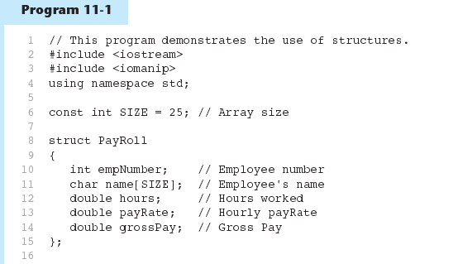
Accessing Structure Members - example

Slide 14
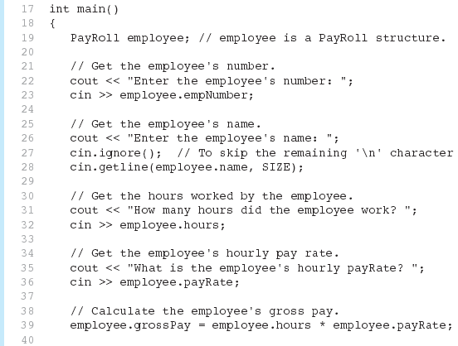
Program11-1 (Continued)‏

Slide 15
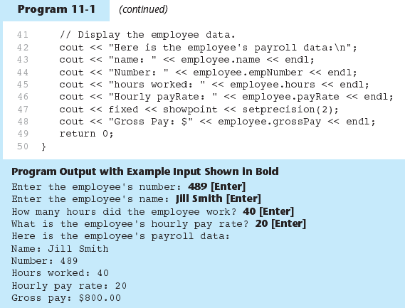
Program11-1 (Continued)‏

Slide 16
Displaying a struct Variable
To display the contents of a struct variable, must display each field separately, using the dot operator:
  cout << bill; // won’t work
  cout << bill.studentID << endl;
  cout << bill.name << endl;
  cout << bill.yearInSchool;
  cout << " " << bill.gpa;

Slide 17
Comparing struct Variables
Cannot compare struct variables directly:
  if (bill == william)
  // won’t work
Instead, must compare on a field basis:
  if (bill.studentID ==
  william.studentID) ...

Slide 18
Exercise Week 9_2
Refer to Exercise 1 No. 2 i-ix pg. 101 Lab 7.
Solve the problem.

Slide 19
Week 9.4
Initializing a Structure

Slide 20
Initializing a Structure
struct variable can be initialized when defined:
  Student s = {11465, "Joan", 2, 3.75};
Can also be initialized member-by-member after definition:
  s.name = "Joan";
  s.gpa = 3.75;

Slide 21
More on Initializing a Structure
May initialize only some members:
  Student bill = {14579};
Cannot skip over members:
  Student s = {1234, "John", ,
  2.83}; // illegal
Cannot initialize in the structure declaration, since this does not allocate memory

Slide 22
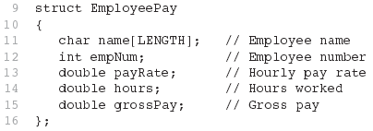
Excerpts From Program 11-4

Slide 23
Exercise Week 9_3
Refer to Program 7.1 pg. 101 Lab 7
Write a complete program to:
  Initialize structure variables radius and rumbia to the value listed in Table 7.1.
  Display all the values in both variables to screen

Slide 24
Week 9.5
Arrays of Structures

Slide 25
Arrays of Structures
Structures can be defined in arrays
Can be used in place of parallel arrays
const int NUM_STUDENTS = 20;
Student stuList[NUM_STUDENTS];
Individual structures accessible using subscript notation
Fields within structures accessible using dot notation:
  cout << stuList[5].studentID;

Slide 26
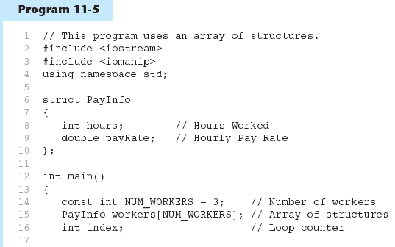
Arrays of Structures

Slide 27
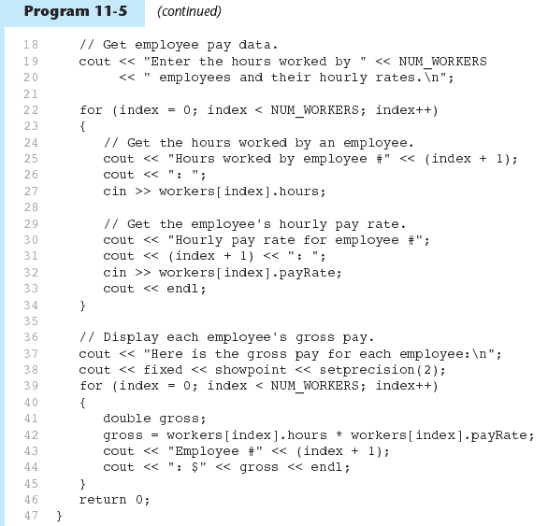
Arrays of Structures - example

Slide 28
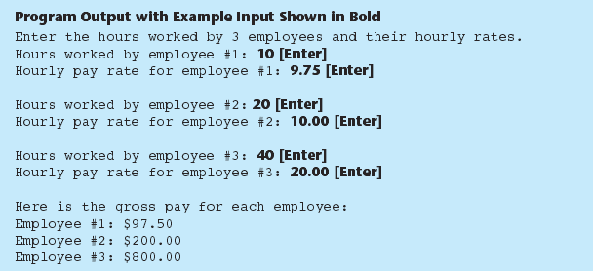
Arrays of Structures - example

Slide 29
Exercise Week 9_4
Recall your solution in Exercise Week 9_3 (pg. 102)
Add the following solution to the program:
  Initialize structure variables kemayan to the value listed in Table 7.1.
  Display all the values in the variable to screen

Slide 30
Week 9.6
Nested Structures

Slide 31
Nested Structures
A structure can contain another structure as a member:
  struct PersonInfo
  { string name,
  address,
  city;
  };
  struct Student
  { int studentID;
  PersonInfo pData;
  short yearInSchool;
  double gpa;
  };

Slide 32
Members of Nested Structures
Use the dot operator multiple times to refer to fields of nested structures:
  Student s;
  s.pData.name = "Joanne";
  s.pData.city = "Tulsa";

Slide 33
Exercise Week 9_5
Refer to Exercise 1 No. 5 pg.103 Lab 7.
Solve the problem.

Slide 34
Week 9.7
Structures as Function Arguments

Slide 35
Structures as Function Arguments
May pass members of struct variables to functions:
  computeGPA(stu.gpa);
May pass entire struct variables to functions:
  showData(stu);
Can use reference parameter if function needs to modify contents of structure variable

Slide 36
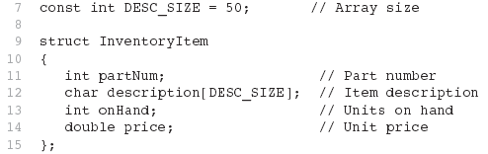
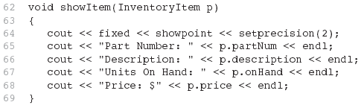
Excerpts from Program 11-7

Slide 37
Structures as Function Arguments - Notes
Using value parameter for structure can slow down a program, waste space
Using a reference parameter will speed up program, but function may change data in structure
Using a const reference parameter allows read-only access to reference parameter, does not waste space, speed

Slide 38
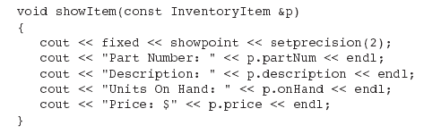
Revised showItem Function

Slide 39
Exercise
Refer to Exercise 1 No. 6 pg.105 Lab 7.
Solve the problem.

Slide 40
Week 9.8
Returning a Structure from a Function

Slide 41
Returning a Structure from a Function
Function can return a struct:
  Student getStudentData(); // prototype
  stu1 = getStudentData(); // call
Function must define a local structure
  for internal use
  for use with return statement

Slide 42
Returning a Structure from a Function - Example
  Student getStudentData()‏
  { Student tempStu;
  cin >> tempStu.studentID;
  getline(cin, tempStu.pData.name);
  getline(cin, tempStu.pData.address);
  getline(cin, tempStu.pData.city);
  cin >> tempStu.yearInSchool;
  cin >> tempStu.gpa;
  return tempStu;
  }

Slide 43
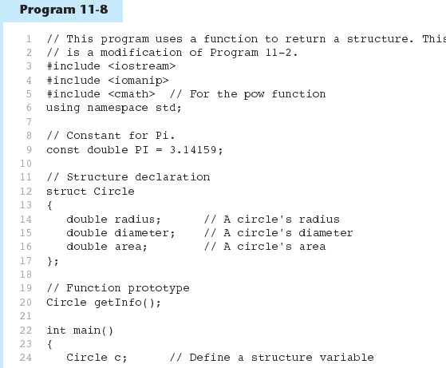
Returning a Structure from a Function - Example

Slide 44
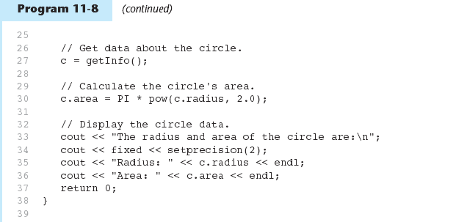
Returning a Structure from a Function - Example

Slide 45
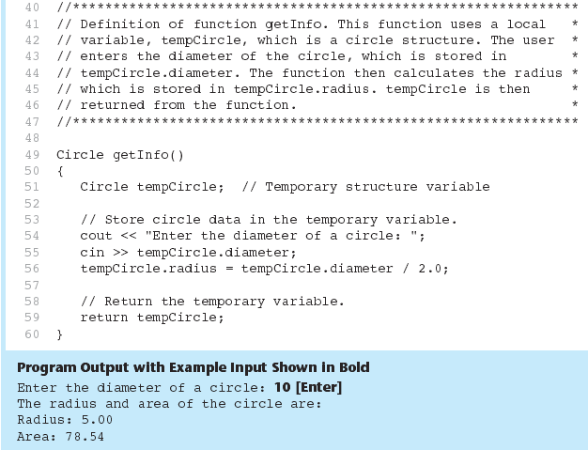
Program 11-8 (Continued)‏

Slide 46
Exercise Week 9_6
Refer to Exercise 3 No. 1 page 114 Lab 7.
Solve the problem

Slide 47
Week 9.9
Pointers to Structures

Slide 48
Pointers to Structures
A structure variable has an address
Pointers to structures are variables that can hold the address of a structure:
  Student *stuPtr;
Can use & operator to assign address:
  stuPtr = & stu1;
Structure pointer can be a function parameter

Slide 49
Accessing Structure Members via Pointer Variables
Must use () to dereference pointer variable, not field within structure:
  cout << (*stuPtr).studentID;
Can use structure pointer operator to eliminate () and use clearer notation:
  cout << stuPtr->studentID;

Slide 50
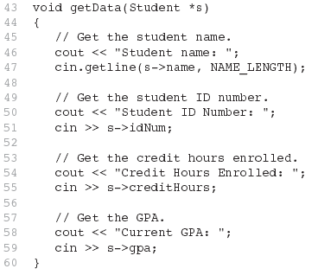
From Program 11-9

Slide 51
Exercise Week 9_7
Refer to Exercise 1 No. 7 page 106 Lab 7.
Solve the problem.

Slide 52
Week 9.11
Unions

Slide 53
Unions
Similar to a struct, but
  all members share a single memory location, and
  only one member of the union can be used at a time
Declared using union, otherwise the same as struct
Variables defined as for struct variables

Slide 54
Exercise
Refer to Exercise 2 No. 4 page 113 Lab 7..
Refer to Exercise 3 No. 5 page 119 Lab 7.
Solve the problems.

Slide 55
Anonymous Union
A union without a union tag:
  union { ... };
Must use static if declared outside of a function
Allocates memory at declaration time
Can refer to members directly without dot operator
Uses only one memory location, saves space

Slide 56
Week 9.11
Enumerated Data Types

Slide 57
Enumerated Data Types
An enumerated data type is a programmer-defined data type. It consists of values known as enumerators, which represent integer constants.

Slide 58
Enumerated Data Types
Example:
enum Day { MONDAY, TUESDAY,
WEDNESDAY, THURSDAY,
FRIDAY };
The identifiers MONDAY, TUESDAY, WEDNESDAY, THURSDAY, and FRIDAY, which are listed inside the braces, are enumerators. They represent the values that belong to the Day data type.

Slide 59
Enumerated Data Types
enum Day { MONDAY, TUESDAY,
WEDNESDAY,THURSDAY,
FRIDAY };
Note that the enumerators are not strings, so they aren’t enclosed in quotes. They are identifiers.

Slide 60
Enumerated Data Types
Once you have created an enumerated data type in your program, you can define variables of that type. Example:
Day workDay;
This statement defines workDay as a variable of the Day type.

Slide 61
Enumerated Data Types
We may assign any of the enumerators MONDAY, TUESDAY, WEDNESDAY, THURSDAY, or FRIDAY to a variable of the Day type. Example:
workDay = WEDNESDAY;

Slide 62
Enumerated Data Types
So, what is an enumerator?
Think of it as an integer named constant
Internally, the compiler assigns integer values to the enumerators, beginning at 0.

Slide 63
Enumerated Data Types
enum Day { MONDAY, TUESDAY,
WEDNESDAY, THURSDAY,
FRIDAY };
In memory...
MONDAY = 0
TUESDAY = 1
WEDNESDAY = 2
THURSDAY = 3
FRIDAY = 4

Slide 64
Enumerated Data Types
Using the Day declaration, the following code...
cout << MONDAY << " "
<< WEDNESDAY << " “
<< FRIDAY << endl;
...will produce this output:
0 2 4

Slide 65
Assigning an integer to an enum Variable
You cannot directly assign an integer value to an enum variable. This will not work:
workDay = 3; // Error!
Instead, you must cast the integer:
workDay = static_cast<Day>(3);

Slide 66
Assigning an Enumerator to an int Variable
You CAN assign an enumerator to an int variable. For example:
int x;
x = THURSDAY;
This code assigns 3 to x.

Slide 67
Comparing Enumerator Values
Enumerator values can be compared using the relational operators. For example, using the Day data type the following code will display the message "Friday is greater than Monday.“
if (FRIDAY > MONDAY)
{
cout << "Friday is greater "
<< "than Monday.\n";
}

Slide 68
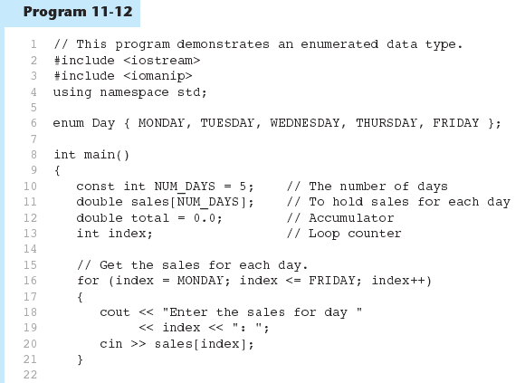
Comparing Enumerator Values - example

Slide 69
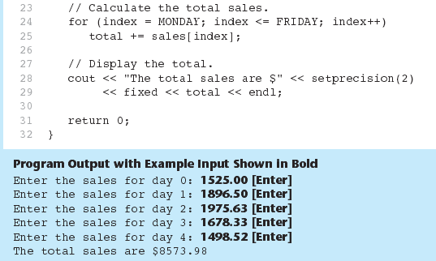
Program 11-12 (Continued)‏

Slide 70
Enumerated Data Types
Program 11-12 shows enumerators used to control a loop:
// Get the sales for each day.
for (index = MONDAY; index <= FRIDAY; index++)
{
cout << "Enter the sales for day "
<< index << ": ";
cin >> sales[index];
}

Slide 71
Exercise Week 9_8
Refer to Exercise 2 No. 3 page 111 Lab 7.
Solve the problem.

Slide 72
Anonymous Enumerated Types
An anonymous enumerated type is simply one that does not have a name. For example, in Program 11-13 we could have declared the enumerated type as:
enum { MONDAY, TUESDAY,
WEDNESDAY, THURSDAY,
FRIDAY };

Slide 73
Using Math Operators with enum Variables
You can run into problems when trying to perform math operations with enum variables. For example:
Day day1, day2;
// Define two Day variables.
day1 = TUESDAY;
// Assign TUESDAY to day1.
day2 = day1 + 1;
// ERROR! Will not work!
The third statement will not work because the expression day1 + 1 results in the integer value 2, and you cannot store an int in an enum variable.

Slide 74
Using Math Operators with enum Variables
You can fix this by using a cast to explicitly convert the result to Day, as shown here:
// This will work.
day2 = static_cast<Day>(day1 + 1);

Slide 75
Using an enum Variable to Step through an Array's Elements
Because enumerators are stored in memory as integers, you can use them as array subscripts. For example:
enum Day { MONDAY, TUESDAY, WEDNESDAY,
THURSDAY, FRIDAY };
const int NUM_DAYS = 5;
double sales[NUM_DAYS];
sales[MONDAY] = 1525.0;
sales[TUESDAY] = 1896.5;
sales[WEDNESDAY] = 1975.63;
sales[THURSDAY] = 1678.33;
sales[FRIDAY] = 1498.52;

Slide 76
Using an enum Variable to Step through an Array's Elements
Remember, though, you cannot use the ++ operator on an enum variable. So, the following loop will NOT work.
Day workDay; // Define a Day variable
// ERROR!!! This code will NOT work.
for (workDay = MONDAY; workDay <= FRIDAY; workDay++)‏
{
cout << "Enter the sales for day "
<< workDay << ": ";
cin >> sales[workDay];
}

Slide 77
Using an enum Variable to Step through an Array's Elements
You must rewrite the loop’s update expression using a cast instead of ++:
for (workDay = MONDAY; workDay <= FRIDAY;
workDay = static_cast<Day>(workDay + 1))‏
{
cout << "Enter the sales for day "
<< workDay << ": ";
cin >> sales[workDay];
}

Slide 78
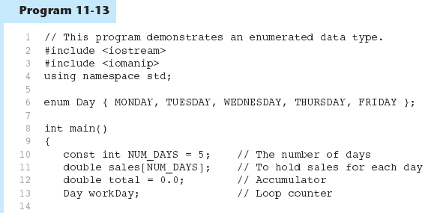
Using an enum Variable to Step through an Array's Elements - example

Slide 79
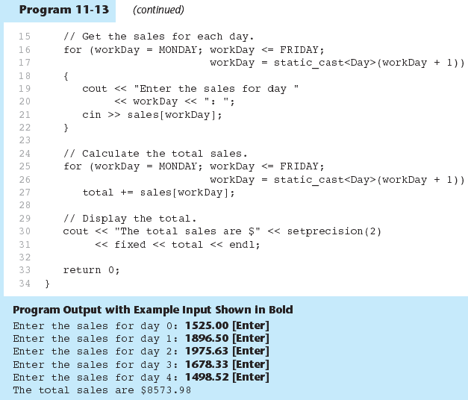
Using an enum Variable to Step through an Array's Elements - example

Slide 80
Enumerators Must Be Unique Within the same Scope
Enumerators must be unique within the same scope. For example, an error will result if both of the following enumerated types are declared within the same scope:
enum Presidents { MCKINLEY, ROOSEVELT, TAFT };
enum VicePresidents { ROOSEVELT, FAIRBANKS,
SHERMAN };
ROOSEVELT is declared twice.

Slide 81
Declaring the Type and Defining the Variables in One Statement
You can declare an enumerated data type and define one or more variables of the type in the same statement. For example:
enum Car { PORSCHE, FERRARI, JAGUAR } sportsCar;
This code declares the Car data type and defines a variable named sportsCar.

Slide 82
Exercise Week 9_9
Refer to Exercise 2 No. 2 page 109 Lab 7.
Solve the problem.

Slide 83
Lab work
Refer to Exercise 3 No. 4 & 5 page Lab 7.
Exercise Week 9_9 (Ex. 2, No. 2)
Solve the problem.
Submit on April 14, 2014

